Slide 1
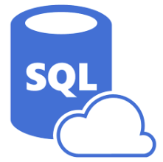
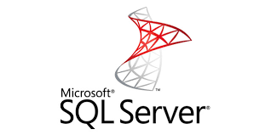

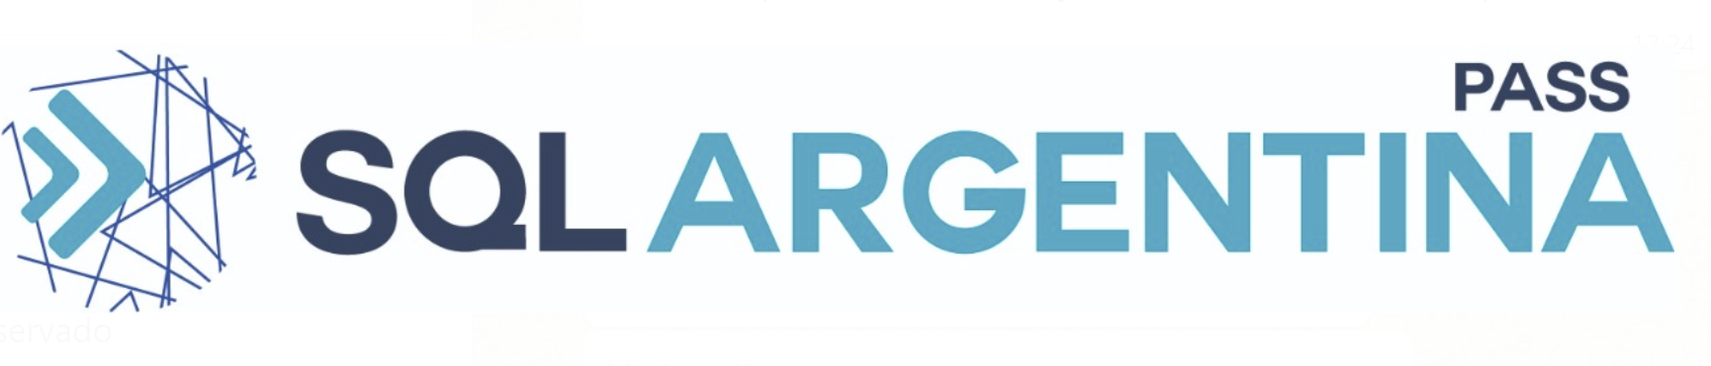
Azure SQL
a fondo

Slide 2


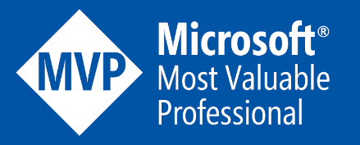
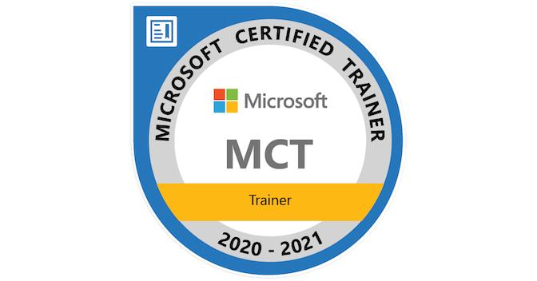
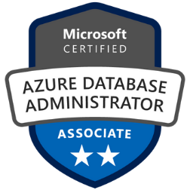
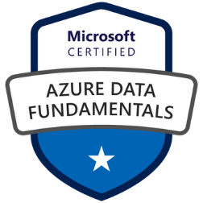


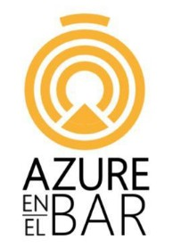

Javier Villegas
IT Director – DBA and BI Services at MSC
Working with the SQL Server for more than 20 years
Microsoft MVP Data Platform
Microsoft Certified Trainer
Azure Data Tech Community Board of Advisors
Technical Speaker
SQL PASS, 24 HOP, SQL Saturdays , PASS Marathon , PASS Virtual Groups, vOpen, Microsoft AI+ Tour, Data Saturdays, Azure Global Bootcamp , GroupBy , PowerBI Summit and DataPlatformGeeks
javier.ignacio.villegas@gmail.com
@javier_vill
javiervillegas
sql-javier-villegas.blogspot.com.ar
@azureenelbar
@sqlargentina

Slide 3



Encuesta
Microsoft Forms

Slide 4
Get Started
Azure Subscription
https://azure.microsoft.com/en-us/free
SQL Server Management Studio & Azure Data Studio
https://aka.ms/ssms
Sample Databases
https://docs.microsoft.com/en-us/sql/samples/sql-samples-where-are

Slide 5
Get Started
Azure Storage Explorer
https://azure.microsoft.com/en-us/features/storage-explorer/
SQL Server Migration Assistant
https://aka.ms/ssma
Data Migration Assistant
https://aka.ms/dma
Database Experimentation Assistant
https://docs.microsoft.com/en-us/sql/dea/database-experimentation-assistant-overview?view=sql-server-ver15

Slide 6

Agenda
Introduccion a Azure SQL
SQL Server en Azure Virtual Machines (VMs)
Azure SQL Database
Azure SQL Managed Instance
Casos de Uso
Performance
Migracion

Slide 7
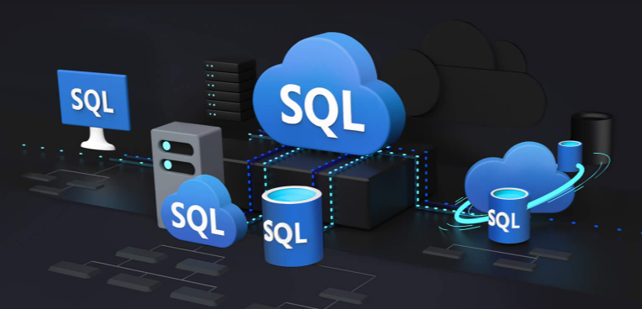
Azure SQL

Slide 8



Azure SQL
A unified SQL portfolio built on the industry-leading SQL Server engine
SQL Server on Azure Virtual Machines
Azure SQL Managed Instance
Azure SQL Database
Best for re-hosting and apps requiring OS-level access and control
Automated manageability features and OS-level access
Best for modernizing existing apps
Offers high compatibility with SQL Server and native VNET support
Best for building new apps in the cloud
Pre-provisioned or serverless compute and Hyperscale storage to meet demanding workload requirements
Infrastructure as a Service
Platform as a Service

Slide 9





Azure SQL
SQL virtual machines
Managed instances
Databases
Best for applications requiring OS-level access or specific SQL version
Best for most migrations to the cloud and modernization along the way
Best for modern cloud applications. Hyperscale and serverless options are available
SQL virtual machine
Single instance
Instance pool
Single database
Elastic pool
SQL Server and OS server access
Expansive SQL and OS version support
Automated manageability features for SQL Server
SQL Server surface area (vast majority)
Native virtual network support
Fully managed service
Resource sharing between multiple instances to price optimize
Enables migration of many small instances at scale
Fully managed service
Hyperscale storage (up to 100TB)
Serverless compute
Fully managed service
Resource sharing between multiple databases to price optimize
Simplified performance management for multiple databases
Fully managed service

Slide 10
IAAS vs PAAS
Relational Database Engines
SQL Server in Azure VM
Azure SQL Database Managed Instance
Azure SQL Database
*
It’s a VM!
Migrate Fleet of Databases
Fully managed Database
Management of OS and SQL Server
Security Isolation with Azure VNet
Active Learning and Optimization
Select Version, OS, Edition
Application Surface Compatibility SQL Agent, Profiler Cross DB querying, CLR, Replication, CDC, Service Broker
End to End Integration
Single VM availability SLA: 99.9% (<43 min downtime p/month)
Multi-VM availability SLA: 99.95% (<21 min downtime p/month)
Intelligent Data Protection & Security
Database sizes up to 35TB
Application & Data Modernization
Minimize Migration Downtime
Up to 4 TB single Databases > using Elastic Scale
All Azure SQL Database features
Geo-DR
Database availability SLA: 99.99%
Notes:
SQL Server sobre Azure VM (IaaS) nos da la opcion de elejir , provicionar y administrar una VM con un OS a nuestra eleccion y correr la version de SQL Server On-Premise
Azure SQL Database -> Base de Datos totalmente manejada ( alta disponibilidad 99.99%, Threat Detention, Inteligente, Hasta 4 TB , Elastic Scale, Medida via DTU, Geo- Replicada
Azure SQL Database Managed Instance -> nuevo sabor de PaaS, con casi 100% de compatilidad con la version On-Premise

Slide 11
IaaS vs PaaS
Business continuity
Scale
High availability
Advanced security
Automated backups
Version-less
Long term backup retention
Built-in monitoring
Geo-replication
Built-in intelligence
Notes:
Business continuity enables your business to continue operating in the face of disruption, particularly to its computing infrastructure.
High availability of Azure SQL Database guarantees your databases are up and running 99.99% of the time, no need to worry about maintenance/downtimes.
2 read replicas - GP
3 replicas, 1 read-scale replica, zone-redundant HA - BC
Primary read/write replica + up to 4 read replicas - HS
Automated backups are created and use Azure read-access geo-redundant storage (RA-GRS) to provide geo-redundancy.
Also Point in Time restore
Long term backup retention enables you to store specific full databases for up to 10 years.
Geo-replication by creating readable replicas of your database in the same or different data center (region). You can manually failover to readable replicas
Also Auto-failover groups allows an application to recover in case of a data center outage
Scale by easily adding more resources (CPU, memory, storage) without long provisioning.
Advanced security detects threats and vulnerabilities in your databases and enables you to secure your data.
Automatic tuning analyzes your workload and provides you the recommendations that can optimize performance of your applications by adding indexes, removing unused indexes, and automatically fixing the query plan issues.
Built-in monitoring capabilities enable you to get the insights into performance of your databases and workload, and troubleshoot the performance issues.
Built-in intelligence automatically identifies the potential issues in your workload and provides you the recommendations that can help you to fix the problems.
Versionless
Azure SQL Database and Managed Instance are versionless
Our “main branch” powers SQL Server, Azure SQL Database, and Managed Instance.
Microsoft consistently updates SQL Server instances
@@VERSION does not align with SQL Server versions
Fixes and feature updates not controlled by users
But…worry-free patching for both underlying OS and SQL Server
Updates are rolled out in “trains”.
New features can be whitelisted to specific customers (aka Private Preview)
Public Preview is typically available to all but limited support and discount pricing (if applicable)
All fixes in SQL Server eventually show up in Azure but timing may be different from CU
Not all fixes in Azure make it into a CU for SQL Server (but typically next major release)
Some fixes are specific to Azure
Follow these links to see new features, major fixes, and feature updates

Slide 12
Focus on your business…
Your work so far | How PaaS helps?
Hardware purchasing and management | Built-in Scales on-demand
Protect data with backups (with health checks and retention) | Built-in Point-In-Time-Restore
High availability implementation | Built-in 99.99% SLA and auto-failover
Disaster recovery implementation | Built-in Geo-redundancy and geo-replication
Ensure compliance with standards on your own | Built-in / easy to use features
Secure your data from malicious users and mistakes | Built-in / easy to use features
Role out updates and upgrades | Built-in
Monitor, troubleshoot and manage at scale | Built-in / easy to use features
Tune and maintain for predictable performance | Built-in/ easy to use features
Notes:
Azure SQL Database Managed Instance tendremos
Independizarnos del proceso de compra e instalacion del Hardware
Datos y Backups automatizados y protegidos
Impemetacion automatic de HA y DR
Datos seguros (Threat Detention)
Performance predecible

Slide 13
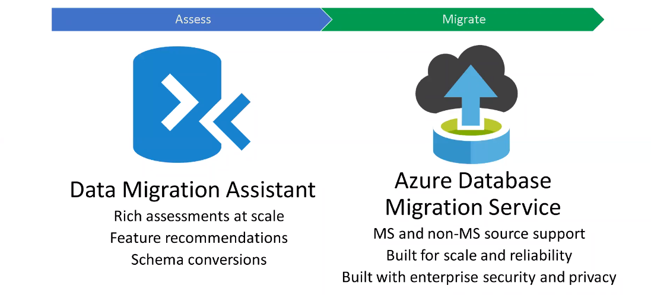
Migration Tools & Services
Notes:
Otros Servicion

Slide 14
SQL Server on Azure Virtual Machines
Marketplace pre-installed SQL Server on Windows or Linux
Install your own SQL Server
Lift and Shift with Azure Migrate (Azure Site Recovery)
Deployment Choices
Unlock Licensing and Edition Flexibility
Automated Backups and Security Updates
Manage VMs through Azure SQL in portal
Resource Provider
Memory or Storage optimized sizes for best performance
Data and log on Premium Storage Managed Disks
Azure Blob Read Caching for data disks
Tempdb on local SSD
Ultra disks for extremely low latency needs
Sizes and Storage Performance
Networking and Security
Virtual Networks to integrate with on-premises
Advanced Data Security services (Preview)
Azure VM built-in HA
Azure Storage built-in DR
Azure Backup and Automated backups to Azure Blob Storage
File-Snapshot Backups
Failover Cluster Instance with Azure Premium File Share
Always On Availability Groups with Cloud Witness
Hybrid Availability Group Secondary replicas
HADR on RedHat Linux with Pacemaker and fencing
HADR

Slide 15
SQL Server on Azure Virtual Machines
SQL Server on Azure Virtual Machines
Best practices for SQL Server on Azure VMs
VM size: Performance best practices for SQL Server on Azure VMs
Storage: Performance best practices for SQL Server on Azure VMs
Performance best practices for SQL Server in Azure Virtual Machines (Github)
SQL Server on Azure VM documentation

Slide 16
Use Cases (SQL Server on Azure VMs)
Lift and Shift
Easy Migration Path
Compatibility

Slide 17
Azure SQL
SQL Server on Azure Virtual Machines

